Slide 1
Unit 4
VOLUNTEER WORK
Language Focus

Slide 2
Let's list the content of the lesson
PRONUNCIATION
/w/ and /j/
GRAMMAR
Gerund and Perfect Participle
Perfect Gerund and Perfect Participle

Slide 3
I - PRONUNCIATION
/w/
/j/

Slide 4
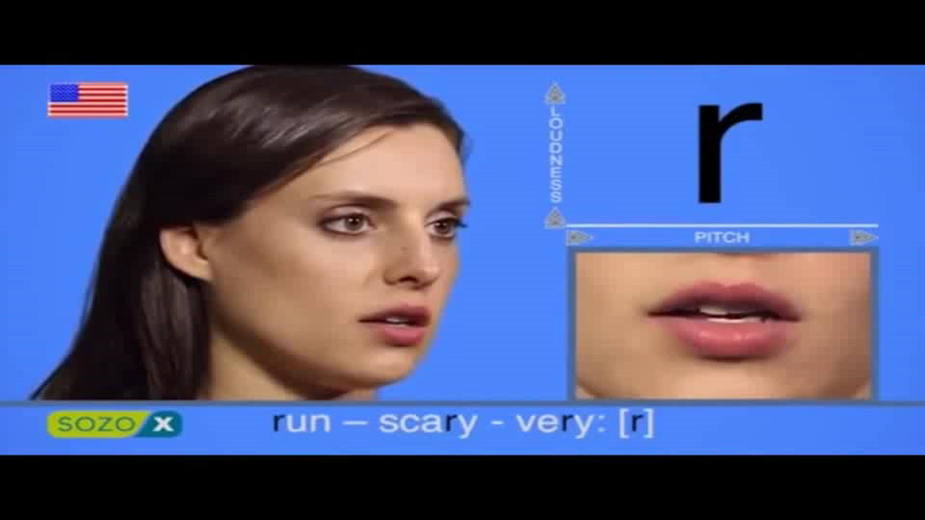
The consonant [ w ]

Slide 5

The consonant [ j ]

Slide 6
I. PRONUNCIATION
/w/ /j/
we
wheel
yes
years
west
wet
yellow
use
wine
whale
young
York

Slide 7
Practice these sentences
We went for a walk in the woods near the railway.
At about twelve, we had veal sandwiches and sweet
white wine, and we watched TV
Excuse me. Did you use to live in York?
We wore warm clothes and walked quickly to keep warm.
Did you use to be a tutor at the University?
I read about Hug in the newspaper yesterday

Slide 8
II - GRAMMAR
Gerund and Perfect Participle
Perfect Gerund and Perfect Participle

Slide 9
1. Gerund and Present participle
The Gerund and the Present participle have the same form: V + ing.
a/ GERUND: The Gerund often acts like a verb and a noun at the same time. It can be used:
- as the subject of a sentence.
Ex: Playing tennis is not expensive in England.
- as complement of a verb.
Ex: What I have to do now is writing a letter to her.

Slide 10
- after prepositions
Ex: I’m afraid of going out alone in the dark.
after certain verbs such as enjoy, miss, finish, delay, avoid, suggest, risk, postpone, admit,……..
Ex: I enjoy walking in the countryside.
b/ PRESENT PARTICIPLE:
The Present participle indicates action, more like a verb or an adjective. It can be used:
as a verb in the continuous tense form.
Ex: She is playing tennis.
as an adjective.
Ex: It’s a worrying problem.

Slide 11
- to replace a relative clause
Ex: The girl (who is) standing over there is Alice.
- to replace subject + verb in the main or subordinate clauses.
Ex: Entering the room, I saw him.
- after the verbs catch/ find/ leave + object
Ex: I caught him stealing my bike.
Don’t leave her waiting outside in the rain.
- after some verbs such as: waste, spend, go, be busy, …..
Ex: You waste time copying the lesson again.
- after verbs of perception such as see, hear, smell, observe, notice, watch, …
Ex: I heard him coming into the hall.

Slide 12
2. Perfect Gerund and Perfect participle:
+ PERFECT GERUND is the perfect form of the gerund. It is used to refer to a past action.
Ex: He admitted having stolen my bike.
+ PERFECT PARTICIPLE is the perfect form of the present participle. It is used when one action happens before another action.
Ex: Having finished her work, she went home.

Slide 13
Underlining the ING-form words and identifying which is gerund or present participle, perfect gerund or perfect participle
1.” Where is Sally?” – She is playing tennis.
2. It is a worrying problem.
3. The girl standing over there is Alice.
4. Playing tennis is not expensive in England.
5. I enjoy walking in the countryside.
6. I heard him coming into the hall.
7. Having finished the work, he went home.
8. He admitted having stolen my bike.
Present participle
Present participle
Present participle
Gerund
Gerund
Present participle
Perfect Participle
Perfect Gerund

Slide 14
Exercise 1: Complete each of the following sentences with an appropriate gerund of the verbs from the box.
spend behave wait park start bend meet listen
Example:
He found that parking was difficult in that city.

Slide 15
spend behave wait park start bend meet listen
listening
1- I have no objection to _______ to your story again.
2- Touch your toes without _______ your knees!
3- You should be ashamed of yourself for _______ so badly.
4- I am looking forward to _______ you.
5- You can’t prevent him from ________ his own money.
6- Would you mind ______ for a moment?
7- In spite of _______ late, we arrived in time.
bending
behaving
meeting
spending
waiting
starting

Slide 16
Exercise 2: Complete of the following sentence with an appropriate present participle of the verb from the box.
lie modernize shop pass prepare rise try read burn
Example:
I saw him ________ my house.
→ I saw him passing my house.

Slide 17
lie modernize shop pass prepare rise try read burn
burning
1. She smelt something ______ and saw
smoke _____.
2. If she catches you ______ her diary, she’ll be furious.
3. The found a tree ____ across the road.
4. I’m going ________ this afternoon.
5. He doesn’t spend much time ________
his lessons.
6. They wasted the whole afternoon _____ to repair the bike.
7. They spend a lot of money __________
the house.
rising
reading
lying
shopping
preparing
trying
modernizing

Slide 18
Exercise 3: Put the verb in brackets into the perfect gerund or perfect participle.
Example:
He was accused of _______ (desert) his ship two months ago.
He was accused of having deserted his ship two months ago.

Slide 19
having made
I object to him ___________ (make) private calls on the office phone.
2. __________ (be) his own boss for such a long time, he found it hard to accept orders from another.
3. They denied ___________ (be) there.
__________ (tie) one end of the rope to his bed, he threw the other end out of the window.
___________ (read) the instruction, he snatched up the fire extinguisher.
6. The children admitted ___________ (take) the money.
→ PERFECT GERUND
Having been
→ PERFECT PARTICIPLE
having been
→ PERFECT GERUND
Having tied
→ PERFECT PARTICIPLE
Having read
→ PERFECT PARTICIPLE
having taken
→ PERFECT GERUND

Slide 20
HOMEWORK
- Do the exercises in the textbook again.
- Write 5 sentences using gerund and 5 sentences using participle

Slide 21
Thank you

